Slide 2


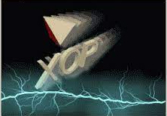
Modelling synchrotron radiation beamlines with
OASYS
Transport of power in a Beamline
Manuel Sanchez del Rio
srio@esrf.fr
Advanced Analysis & Precision Unit, MEG/ISDD, ESRF
March 21st 2025
XOPPY

Slide 3
Transport of power in a Beamline
Outline:
Source emission: Flux and power spectra.
Optical elements: characteristics and absorbed power.
Flux and power that arrive to the sample
XOPPY

Slide 4
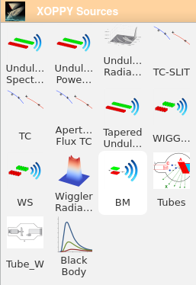
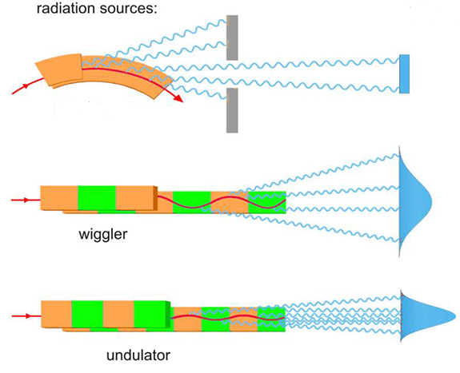
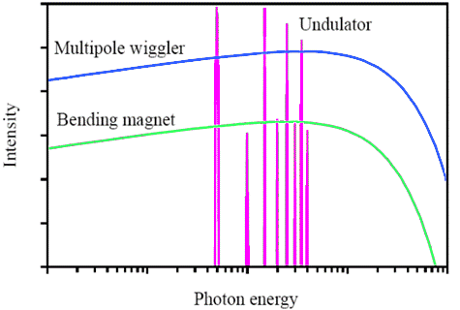
Simulation of source emission
Source spectrum (Photon flux or power vs Energy)
XOPPY
Undulator
Wiggler
bending magnet
Bending
magnet

Slide 5
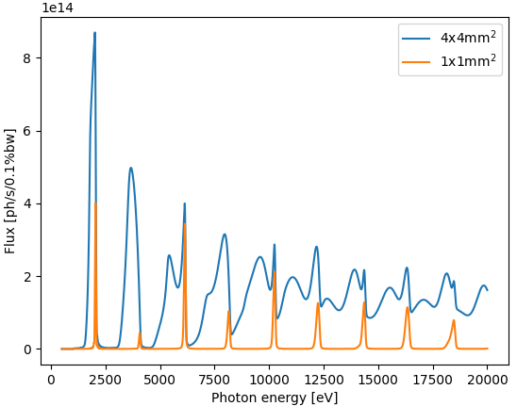
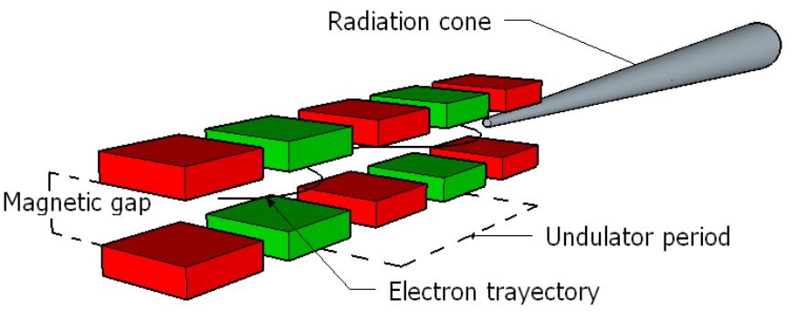
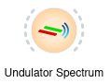
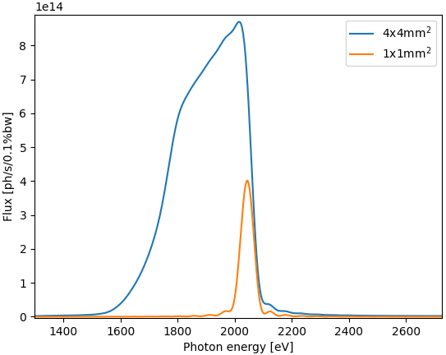

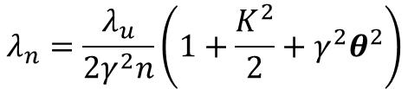
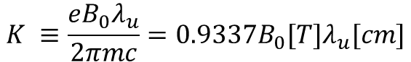
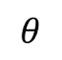
Undulator emission simulation
XOPPY
$$K ≡\frac{eB_{0}λ_{u}}{2πmc}=0.9337B_{0}[T]λ_{u}[cm]$$
$$λ_{n}=\frac{λ_{u}}{2γ^{2}n}\left(1+\frac{K^{2}}{2}+γ^{2}θ^{2}\right)$$
Slit
U42
$$θ$$
30 m

Slide 6
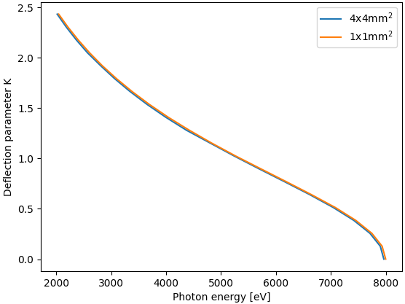
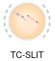
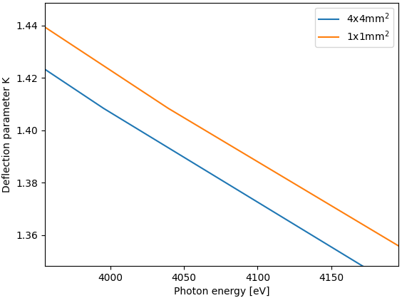
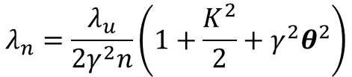
Undulator emission simulation
XOPPY
1st harmonic
$$λ_{n}=\frac{λ_{u}}{2γ^{2}n}\left(1+\frac{K^{2}}{2}+γ^{2}θ^{2}\right)$$
~50 eV
U42
Slit
$$θ$$
30 m

Slide 7
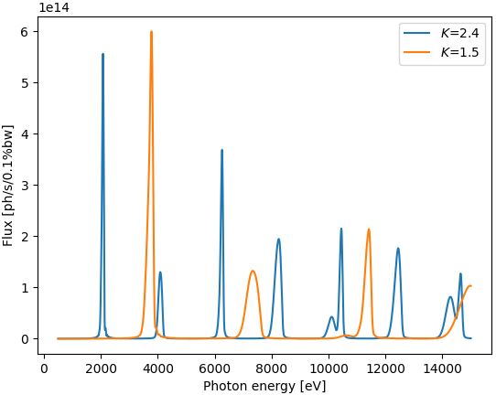

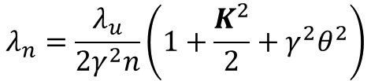
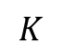
Undulator emission simulation
XOPPY
$$λ_{n}=\frac{λ_{u}}{2γ^{2}n}\left(1+\frac{K^{2}}{2}+γ^{2}θ^{2}\right)$$
U42
$$K$$

Slide 8
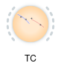
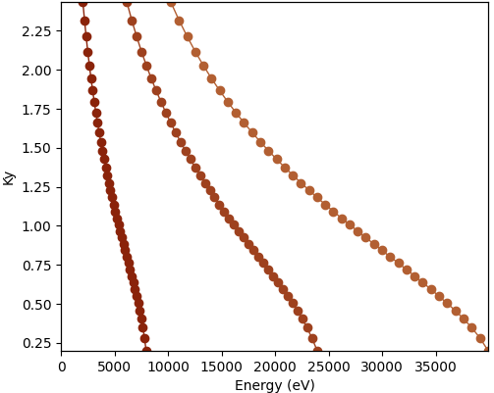
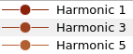
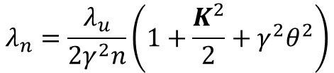
Undulator emission simulation
XOPPY
$$λ_{n}=\frac{λ_{u}}{2γ^{2}n}\left(1+\frac{K^{2}}{2}+γ^{2}θ^{2}\right)$$
U42
$$K$$

Slide 9
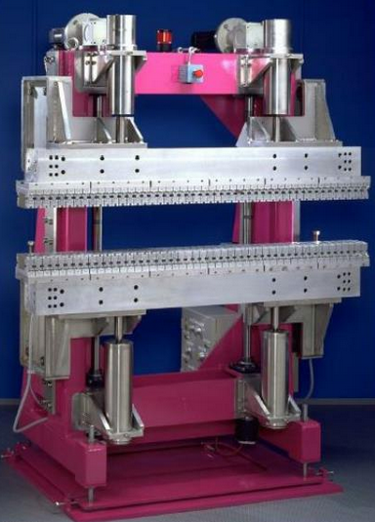

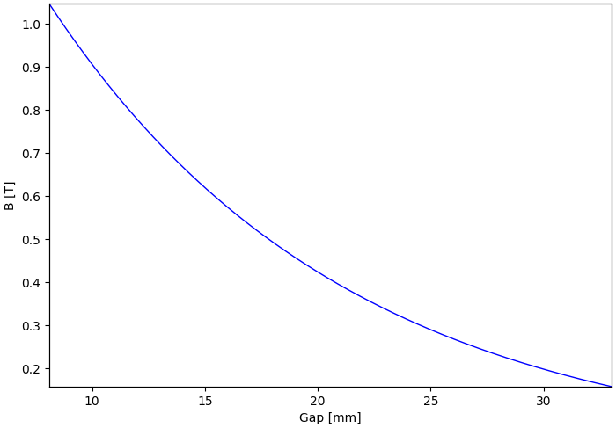
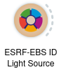
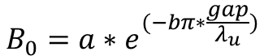
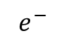
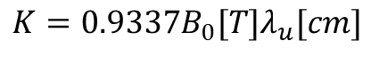
Undulator emission simulation (gap)
$$e^{−}$$
Gap
$$K=0.9337B_{0}[T]λ_{u}[cm]$$
$$B_{0}=a∗e^{(−bπ∗\frac{gap}{λ_{u}})}$$
For ID21 U42b:
a=1.9395
b=1.0164

Slide 10
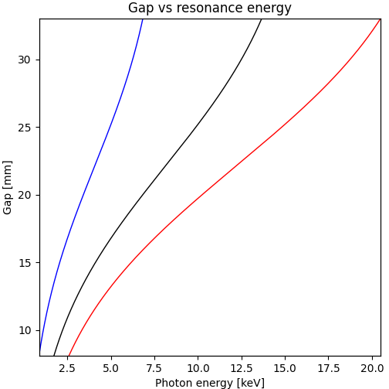
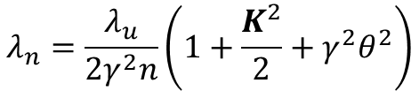
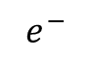
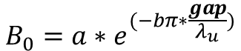
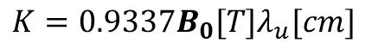
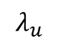
Undulator emission simulation
$$e^{−}$$
Gap
$$λ_{u}$$
Reducing
the gap
larger wavelength
(shorter energy)
incrementing K
$$B_{0}=a∗e^{(−bπ∗\frac{gap}{λ_{u}})}$$
$$K=0.9337B_{0}[T]λ_{u}[cm]$$
$$λ_{n}=\frac{λ_{u}}{2γ^{2}n}\left(1+\frac{K^{2}}{2}+γ^{2}θ^{2}\right)$$

Slide 11
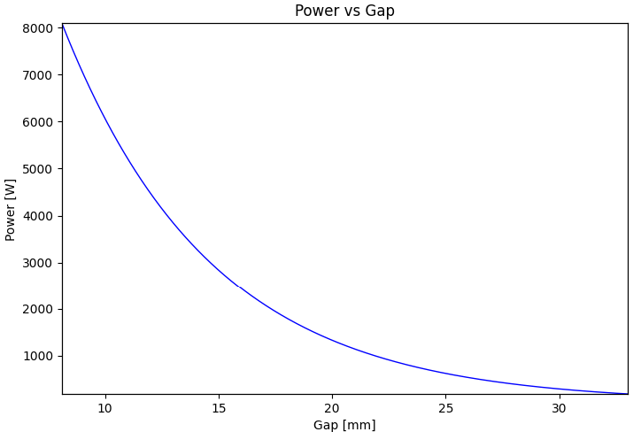
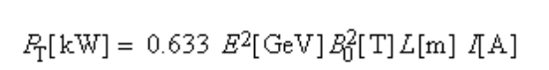
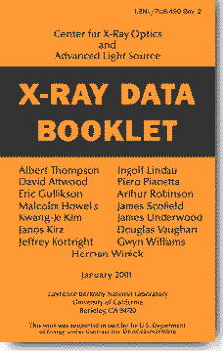
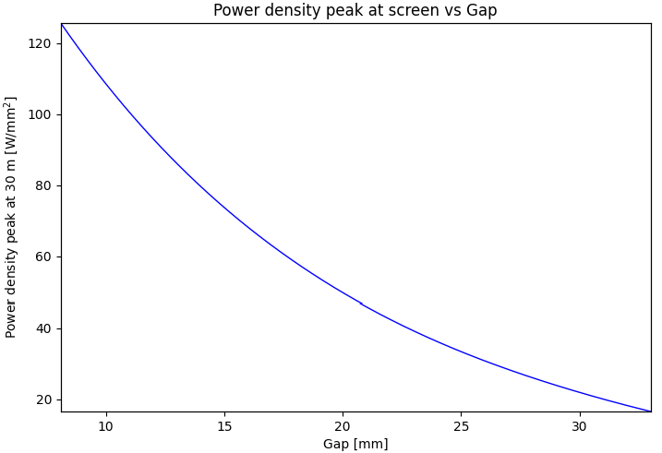
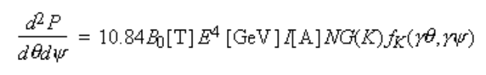
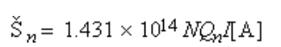
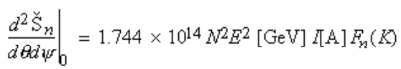
Undulator emission simulation
$$e^{−}$$
Gap
$$λ_{u}$$
Reducing
the gap
More power
Ref:
Central cone flux
On-axis flux

Slide 12
Simulation of source emission
Undulator power density (power vs x, y)
Undulator spectral flux density (flux/power vs x, y, E)
Wiggler spectral flux density (flux/power vs x, y, E)

Slide 13
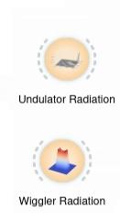
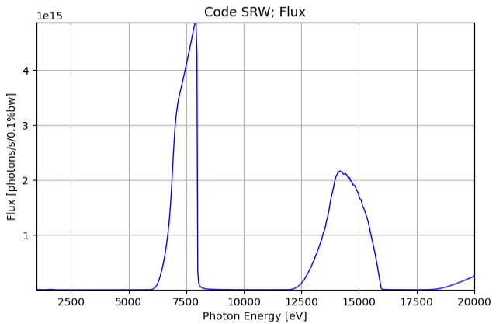
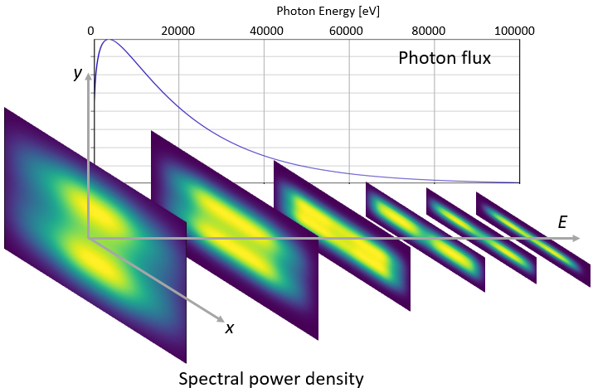
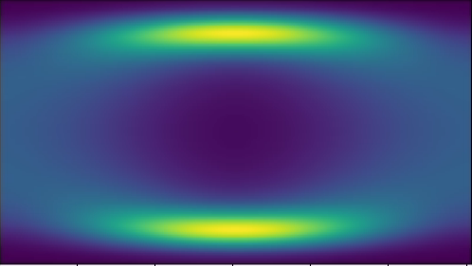
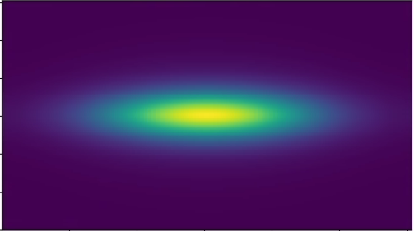
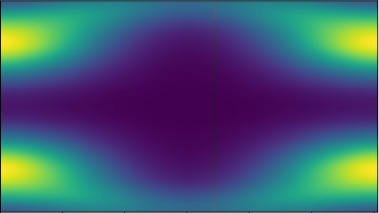
Simulation of source emission
Undulator spectral flux density
(flux/power vs x, y, E)
Wiggler spectral flux density
(flux/power vs x, y, E)
Photon Energy [eV]
1000 5000 10000 15000 20000
y
Photon flux
E
x

Slide 14
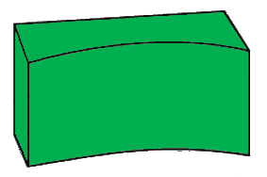
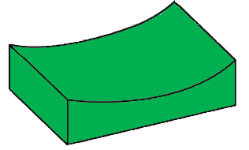
Power transport on a beamline
Optical components that could be present in a beamline:
Focusing system
Front end
Primary slits
Monochromator
Source
Sample
Primary mirrors
KB mirrors
Water-cooled
slits
Windows

Slide 15
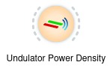



Undulator power density (Power vs x, y)
For example, this tool is very useful to get the heat load on a slit:
Water cooled beamline slit
undulator

Slide 16



Undulator power density (Power vs x, y)
In most of the beamlines at the ESRF the are horizontal slits at 16 m from the source:
Perpendicular to the beam
Project over the slit surface (2º angle)
X-ray beam
Finite element analysis

Slide 17

Power transport on a beamline
Optical components that could be present in a beamline:
Focusing system
Front end
Primary slits
Monochromator
Source
Sample
Primary mirrors
KB mirrors
Water-cooled
slits
Windows
Slit 1
Aperture (a)
Source
Projected size at
downstream element (A)
Distance from the source (d)
Distance from the source (D)
$$A= \frac{D}{d}a$$

Slide 18



Filter (window) absorption
Filters of different thickness
Filters of different materials

Slide 19



Power absorbed by a filter
Heat load on filters @ 23 m with a projection of 2 mm x 1 mm:
U42-EBS
thickness
Material | Thickness [μm] | Absorbed Power [W]
Be | 300 | 19
Diamond | 300 | 40
X-ray beam
material & density

Slide 20



Power absorbed by a filter
Heat load on filters @ 23 m with a projection of 2 mm x 1 mm:
Be (300 μm)
Diamond (300 μm)

Slide 21
Power transport on a beamline
Optical components that could be present in a beamline:
Focusing system
Front end
Primary slits
Monochromator
Source
Sample
Primary mirrors
KB mirrors
Water-cooled
slits
Windows
Absorption by filters
Slit 1
Aperture (a)
Source
Absorption power by mirror

Slide 22


Mirror absorption
Same material, different angles
Same angle, different coatings

Slide 23




Mirror absorption
1st Harmonic
Example of reflection, primarily mirrors @ 30 m
Absorbed power 113 W
1st Harmonic
3rd Harmonic
3rd Harmonic
Absorbed power 52 W

Slide 24


Power absorbed by a mirror
Heat load on mirrors @ 30 m:
Si (7 mrad)
Diamond (100 μm) + Rh (3 mrad)

Slide 25






Other optical elements in XOPPY
Multilayers
[W(2.5)/Si(2.5)]₅₀
1.4º
$${mλ =2d}_{M}senθ\sqrt{1−\frac{2\overline{δ}}{{sen}^{2}θ}}$$

Slide 26




Other optical elements in XOPPY
Bragg or reflection
Crystals
Double crystal monochromator
Rocking curve
Si (111)
22 keV

Slide 27
Calculation of flux at the sample position
Exercise: estimate the photon flux at the sample position.
KB slits
51 m
Si (111)
Focusing system
Ni coated 7 mrad
Monochromator
Source
Sample
Primary mirrors
KB mirrors
ESRF-ID21
5 keV
Slits aperture 1 mm x 1 mm
Ni coated
6 mrad

Slide 28

Calculation of flux at the sample position
Exercise: estimate the photon flux at the sample position.
KB slits
51 m
Si (111)
Focusing system
Ni coated 7 mrad
Monochromator
Source
Sample
Primary mirrors
KB mirrors
ESRF-ID21
5 keV
Slits aperture 1 mm x 1 mm
Ni coated
6 mrad

